Slide 1
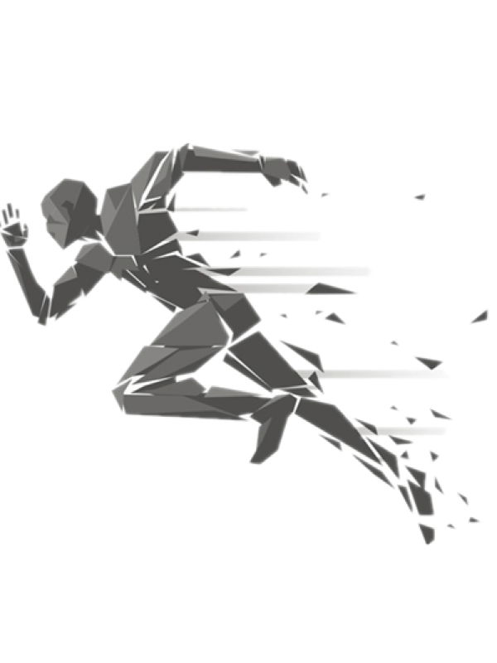
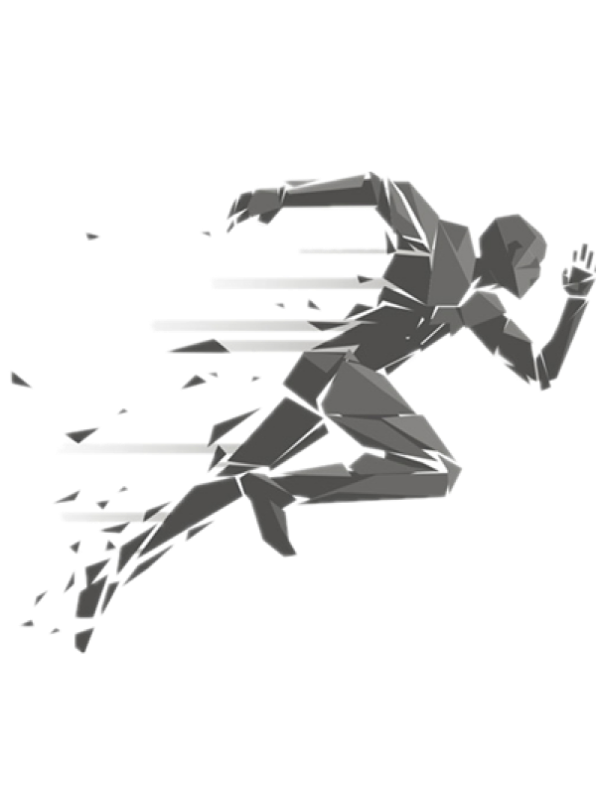

A8 Presentation
Fitness Mobile App
D17 – Energetic Snorlax
Notes:
Greeting and intro team name
Introduce the journey to design the mobile fitness app

Slide 2
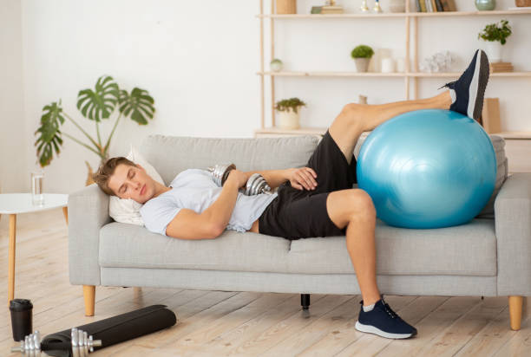
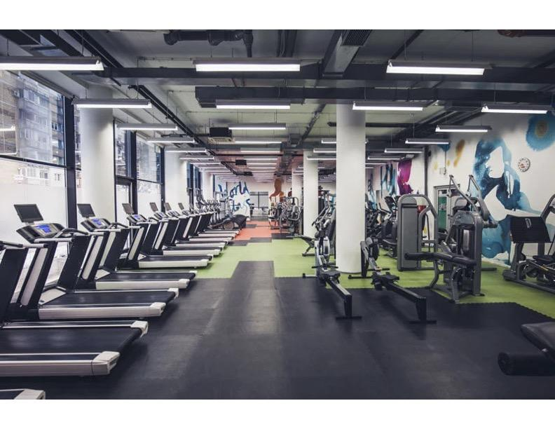
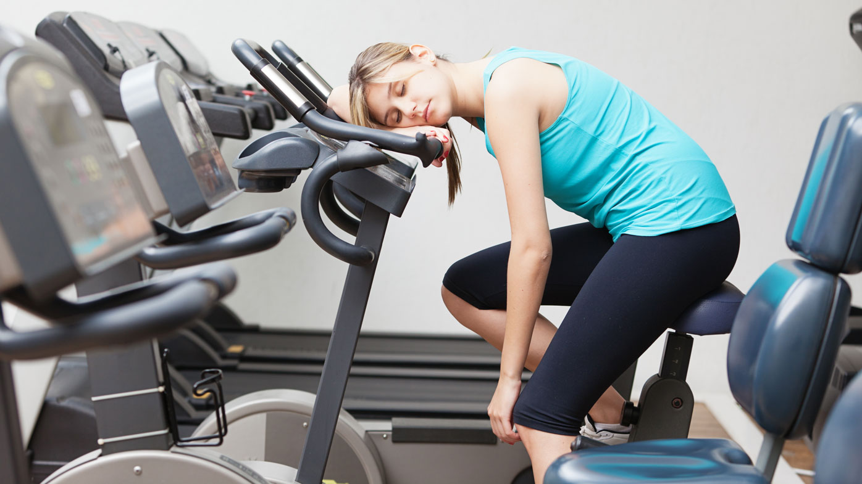
How many times did you give up your fitness plan?
Notes:
Start with this question with my experiences
1. Million times
2. I always find excuses to stay home and play video games
3. If you have the same situation as me here
This is the trigger for our team to design a fitness incentive app.

Slide 3





Part 1 ——Problem space
Problem Space
Design a product to help people to start the physical activity
Target Audience
people aged between 18 and 40 years old who easily give up their fitness plan
.
Notes:
Our problem space is to design a product to help people to start a physical activity
Target Audience: people aged between 18 and 40 years old who easily give up their fitness plan

Slide 4
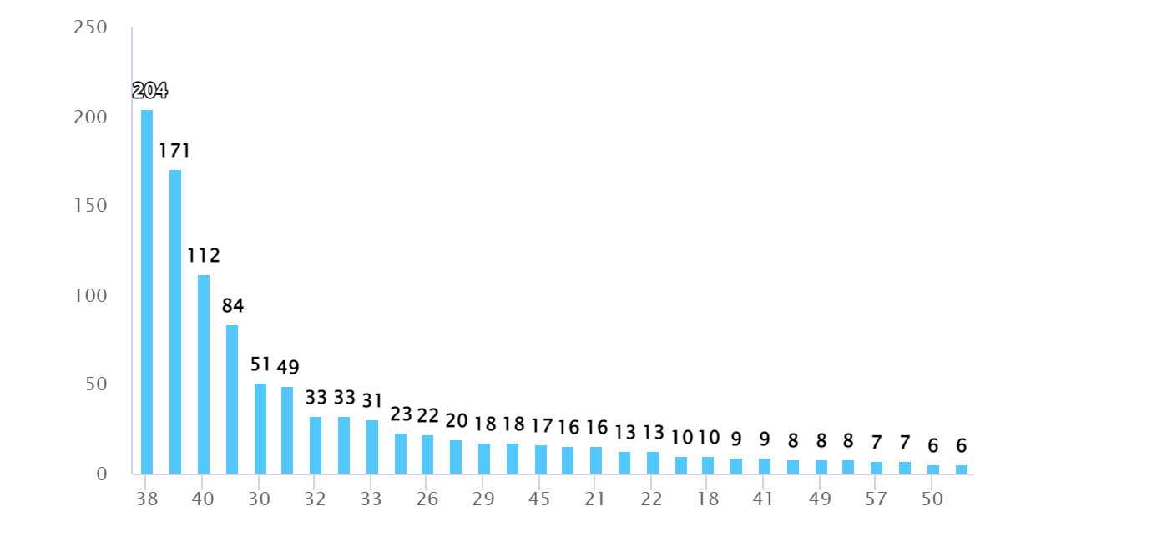
Part 2 ——User research analysis
Number of people
Survey: 1254 results
Interview: 9 stakeholders
Observation: 2current students
Age
Figure 1: Age Distribution
Notes:
three methods :
Got over 1000 survey results
Interviewed nine stakeholders
Observed two university students
Focus on survey result

Slide 5
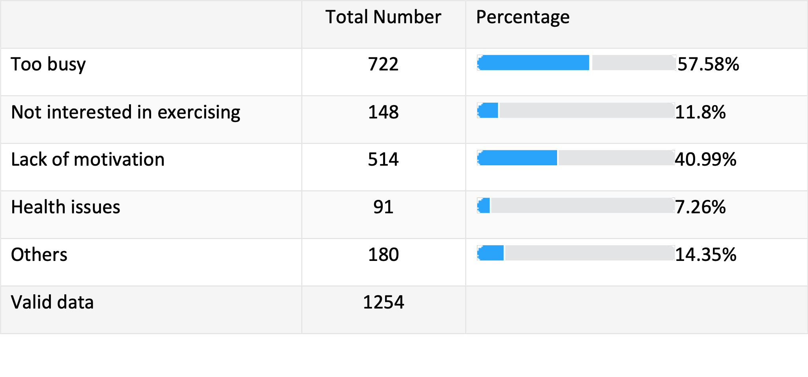
Part 2 ——User research analysis
What reason when you unwilling to exercise?
Main reasons
Too busy
Lack of motivation
Notes:
from survey results we get two main reasons for unwilling to do exercise

Slide 6
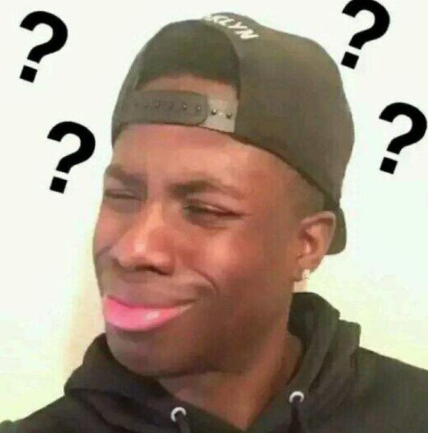

Really Too Busy？
Notes:
is it really too busy?

Slide 7
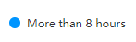
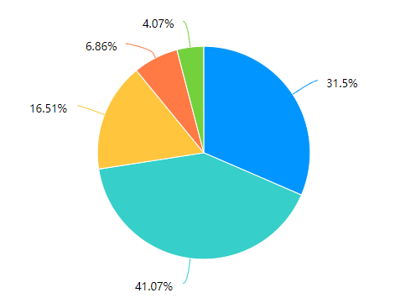
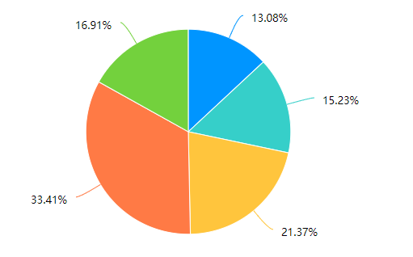
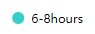
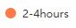
Part 2 ——User research analysis
How much free time do you have each day?
How long do you spend exercising every day?
Figure 2: Free time per day
Figure 3: Exercise time per day
Notes:
we asked two questions about free time per day and exercise time per day in the survey

Slide 8
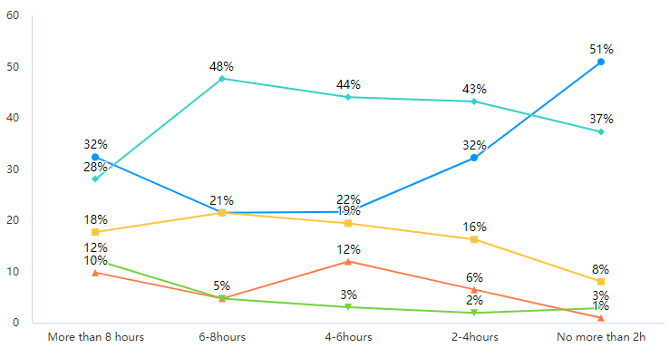
Part 2 ——User research analysis
Free time\Exercise time | No more than 1 hour
More than 8 hours | 60%
6-8 hours | 69%
percentage
Being too busy is just an excuse, not the most important reason
Free time
Figure 4: Cross tabulations
Notes:
we did cross-tabulations with the two questions.
We find out that
among people who have a lot of free time, more than 60% of them spend less than an hour exercising per day.
Too busy is just an excuse

Slide 9
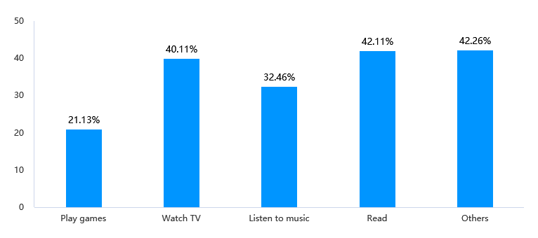
Aside from exercising, how do you spend your free time?
percentage
Activity
Figure 4: Activities other than exercise
Notes:
Because they do a lot of other activities in their free time

Slide 10
Part 2 ——User research analysis
What reason when you unwilling to exercise?
Main reasons
Too busy
Lack of motivation
Notes:
we think maybe the main reason should be lack of motivation to start an exercise

Slide 11
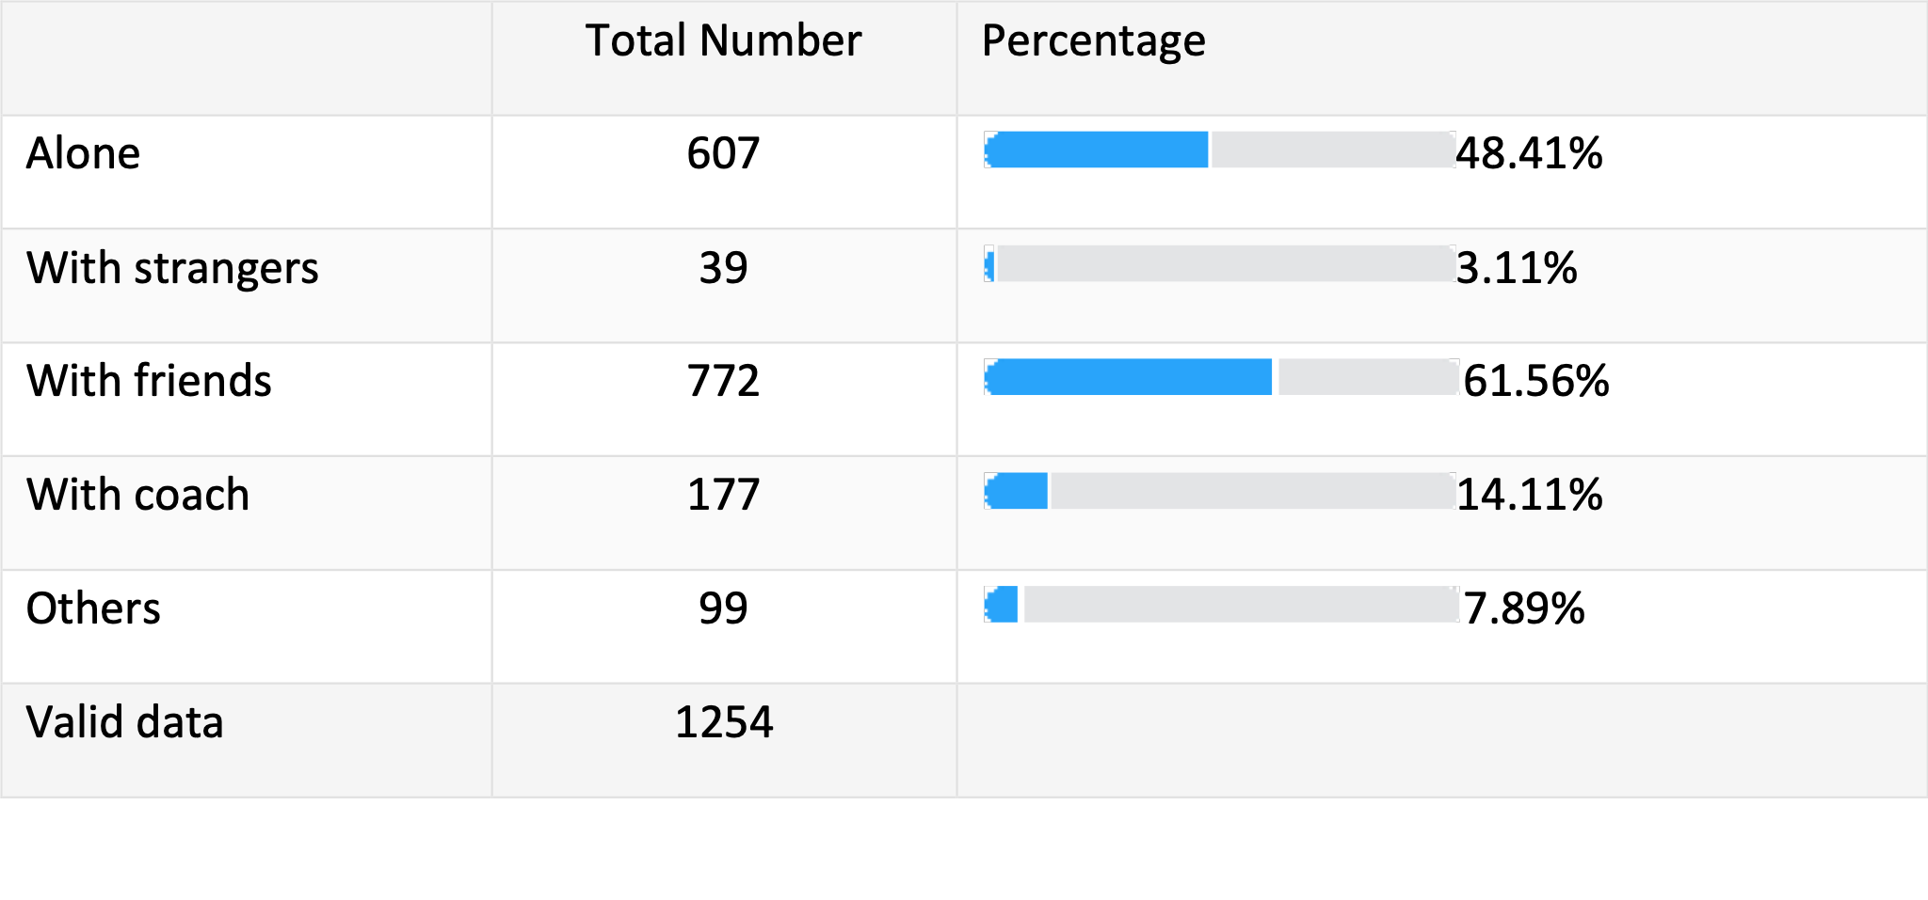
Part 2 ——User research analysis
How do you like to exercise?
Social functions are also important！
Notes:
Now we reach to the most important question in the survey
we find out that people love exercising with their friends.
This corresponds to the result from interviewing the fencing athletes who said group training

Slide 12
Part 3 ——design idea
Achievements
virtual character
Achievements
— A lovely interaction
— Sense of achievement in rank system
Find
Local friends
Virtual character
Find Local Friends
— More motivation from groups
Notes:
from the user analysis, we find the main reason is a lack of motivation to start a physical activity
1. our app design will be focusing on promoting users to start
2. This is different from the current fitness app which mainly focuses on how to build muscles
3. Here is the map for the main features of the design

Slide 13
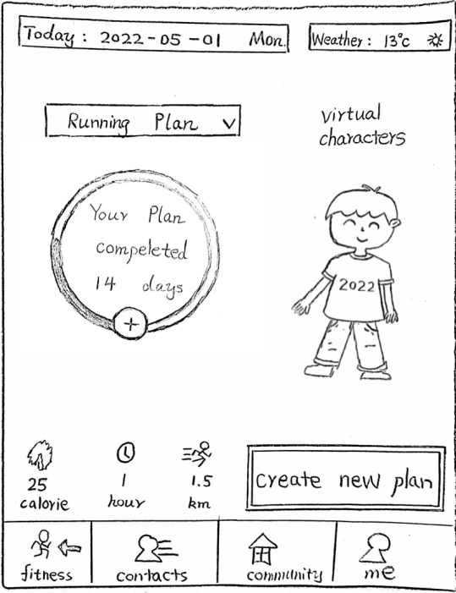
Part 3 ——design idea
Virtual character
interaction with users
attraction
A visible part of the achievement
Notes:
Virtual character is the mini-me for the users.
The virtual character will grow and changes with the users

Slide 14
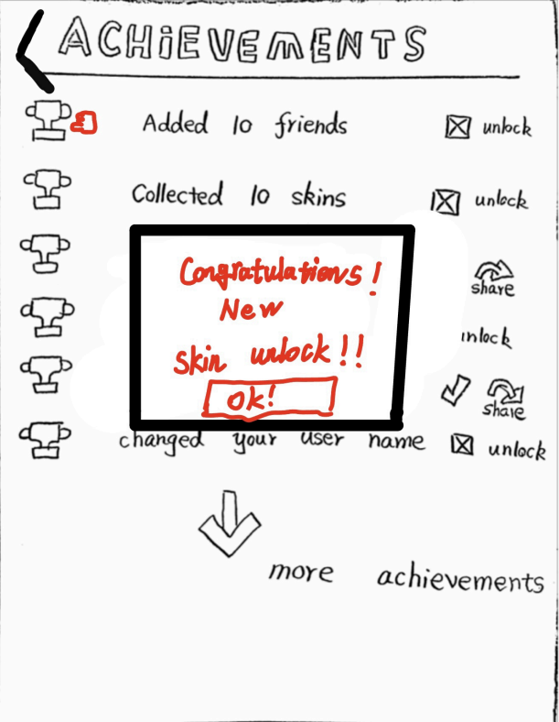
Part 3 ——design idea
Achievements
sense of achievement
provide motivation
Unlock virtual character’s clothes is part of it
Notes:
The achievement feature provides the feeling of success when users finish their fitness plan.
This positive feedback will promote the user to start
and the achievement rewards can be used to unlock some skin features for the virtual character

Slide 15
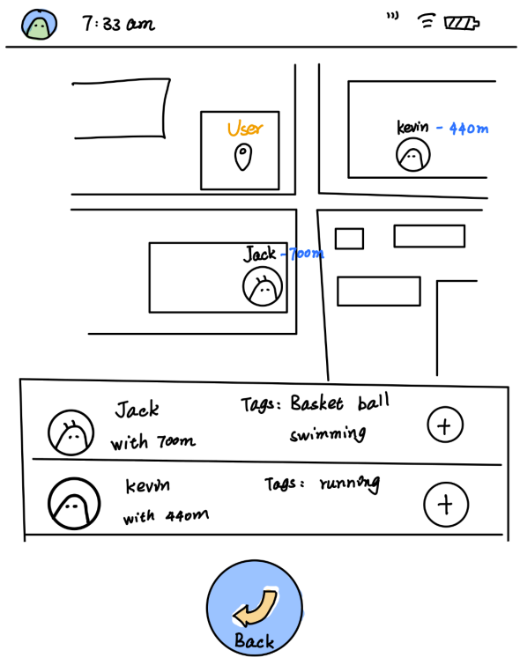
Part 3 ——design idea
Find Local friends
Social networks
group supervision
Notes:
from the user analysis, we find out that people love exercising with friends.
We design this finding local friend feature to connect the users from a virtual screen to the real world.
They can become exercising buddies and even life-long true friends

Slide 16
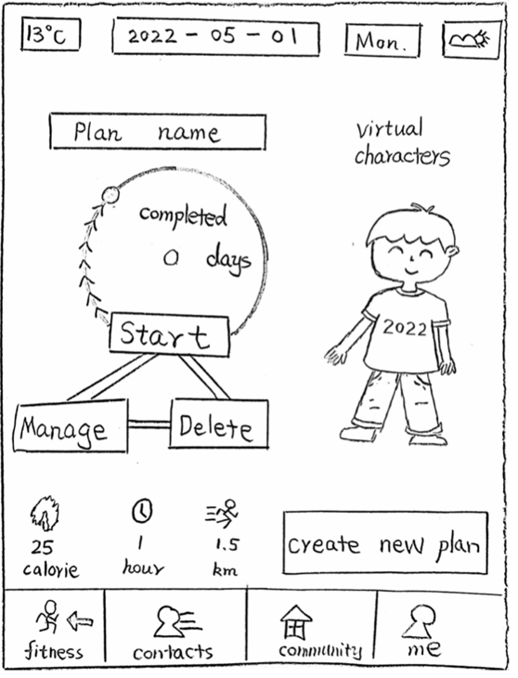
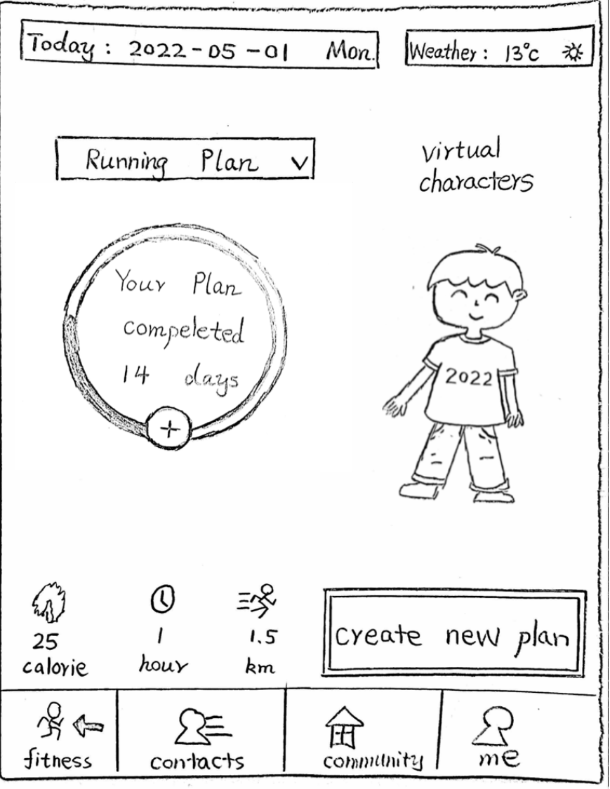
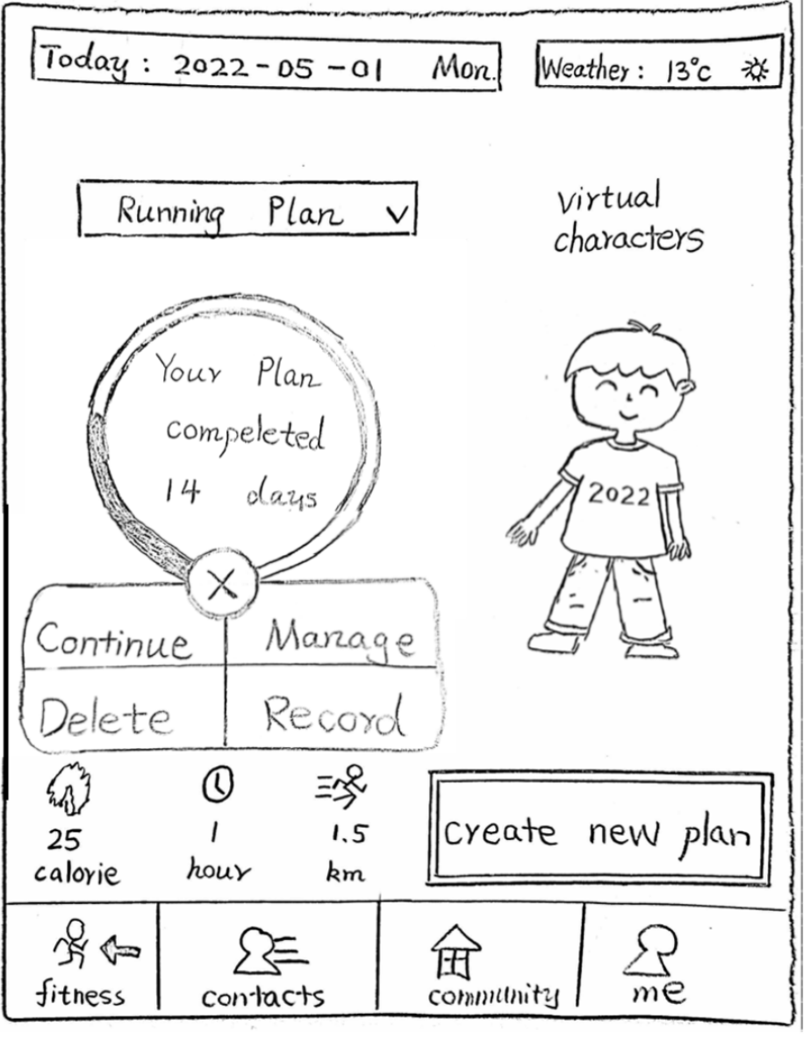


Fun Facts in Improvement
Part 4 —— Iterate Process Of Design
How It Iterate for our fitness page from Low-fi to High-Fi
First Design
After iterate
Notes:
Fitness page
We made a lot of effort designing the multi-function button on the fitness page
We change it to a multi-function pop up button

Slide 17
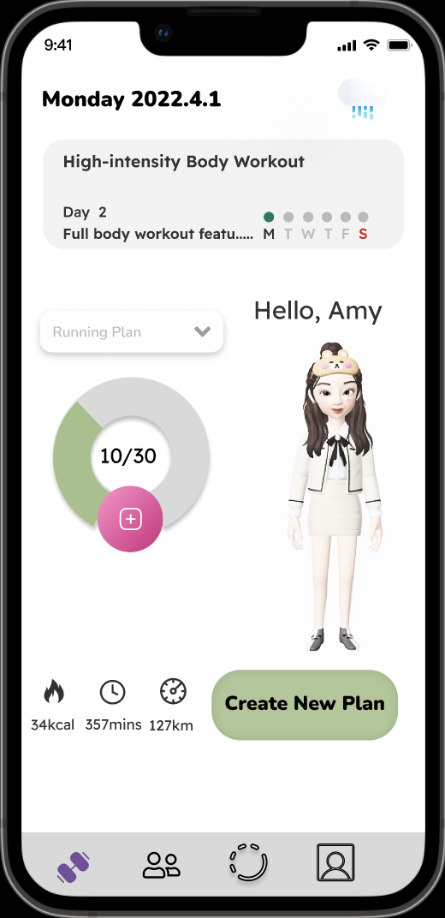
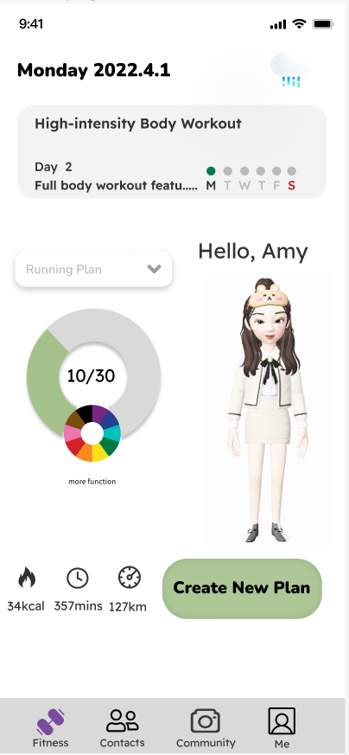
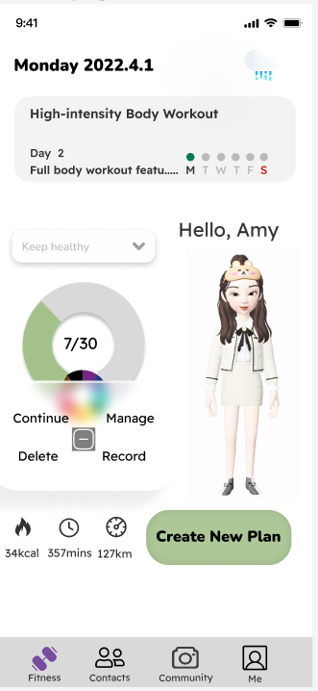
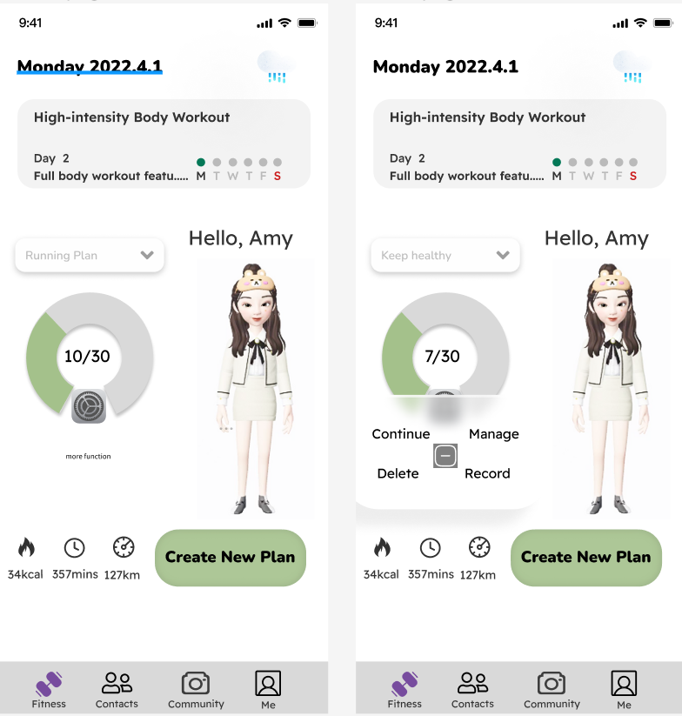
Fun Facts in Improvement
Part 4 —— Iterate Process Of Design
How It Iterate for our fitness page from Low-fi to High-Fi
First Design For High-Fi
After first iterate
Final Version of High-Fi
Notes:
in the pilot user ability test
The plus and rainbow button gives the users hard time to know it is a button to click
We changed it to a gear button to show that it is a multi-function button.

Slide 18
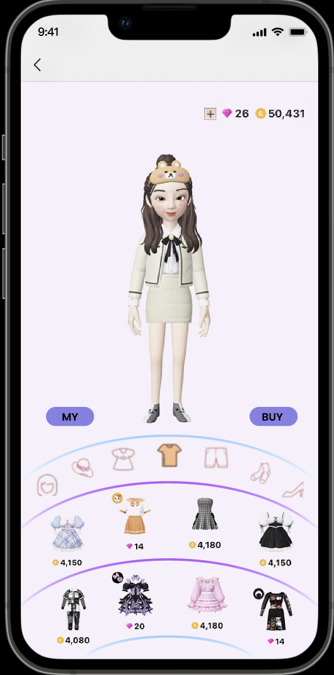
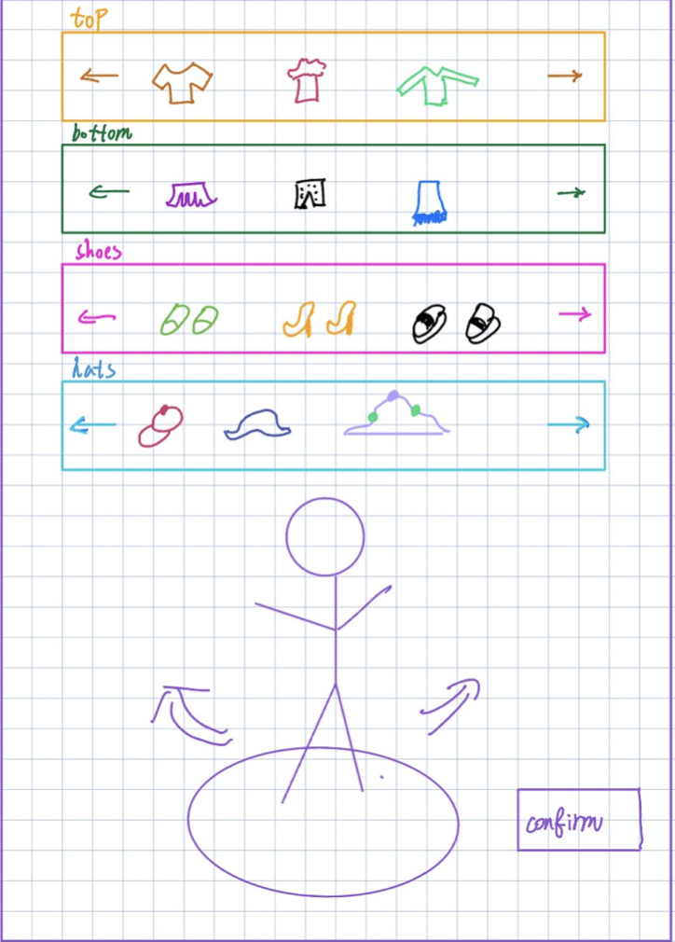
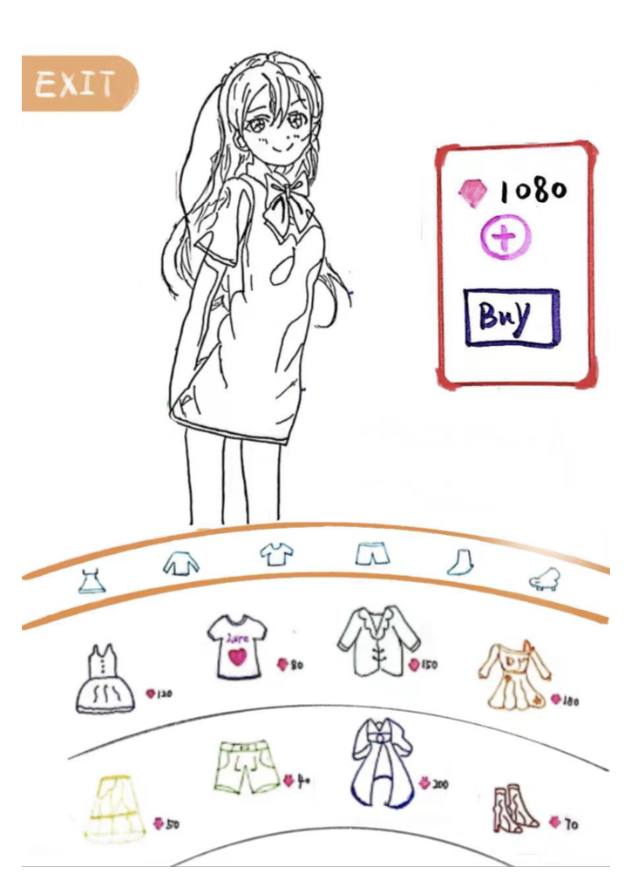
Fun Facts in Improvement
Part 4 —— Iterate Process Of Design
How It Iterate for our fitness page from Low-fi to High-Fi
High-Fi Prototype
First Design
After Iterate
Notes:
Shop
Virtual character is an eye-catching point in our app. We replaced the stick man design with a more virtual appealing one.
We add the details to the panels for different types of outfits
Moreover, in the high-fidelity prototype, we add the my button to indicate the items which the users have.

Slide 19
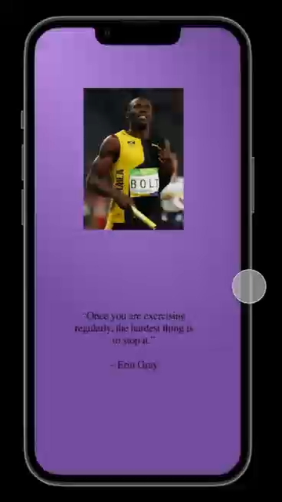
Part 4 —— Iterate Process Of Design

Slide 20
Thank you for watching
D17 – Energetic Snorlax
(1) LI, Ang (2) QIN, Yifan (3) QU, Ziyang (4) WANG, Zeyang (5) ZHANG, Chengshuo (6) ZHANG, Xuchen

